Slide 1


Novel Methods for Generating and Mutating Site-Disordered Materials in an Evolutionary Energy Minimization Framework
Ethan Meltzer, Oberlin College Dept. of Computer Science
Mr. Victor T. Barone, Dr. Richard E. Irving, Dr. Sanjay V. Khare
University of Toledo Dept. Of Physics

Slide 2
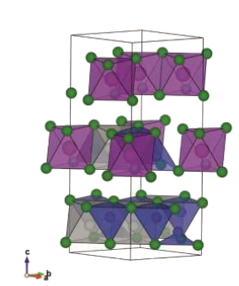
Site-Disordered Cu2AgBiI6
Lead-free semiconductor with order of magnitude greater absorption coeff. (1.0*10⁵
cm⁻¹) in visible spectrum.
  Compete with or exceed efficiency of current gen. thin-film lead-perovskite and CdTe materials
Original research done at University of Liverpool suggests material is highly site-disordered, ~10³¹ configurations possible for 3x3x1 cell
Need to know energy-minimal configurations of the material for proper solar cell chemistry
Figure: Sansom et al. Highly Absorbing Lead-Free Semiconductor Cu2AgBiI6 for Photovoltaic Applications from the Quaternary CuI−AgI−BiI3 Phase Space.
Journal of the American Chemical Society 2021 143 (10), 3983-3992
DOI: 10.1021/jacs.1c00495

Slide 3
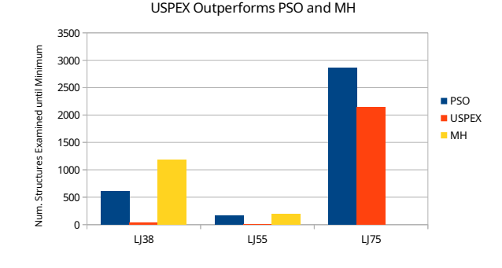
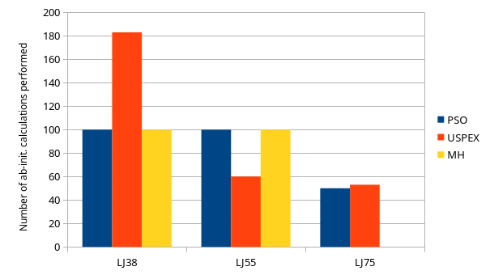
Evolutionary Algorithim and USPEX
Can survey population and find minimum quickly
  Takes advantage of the parallel nature of simulating a generation
Initialize, Select, Breed (combine, crossover, mutate), Repeat (until criteria are met), Terminate
Universal Structure Predictor: Evolutionary Xtallography (USPEX) software implements efficiently, interfaces with VASP
Not optimized for site-disordered materials, will compare with our novel approach focused on first-gen selection
Figures adapted from data available on USPEX website:
https://uspex-team.org/en/uspex/overview

Slide 4
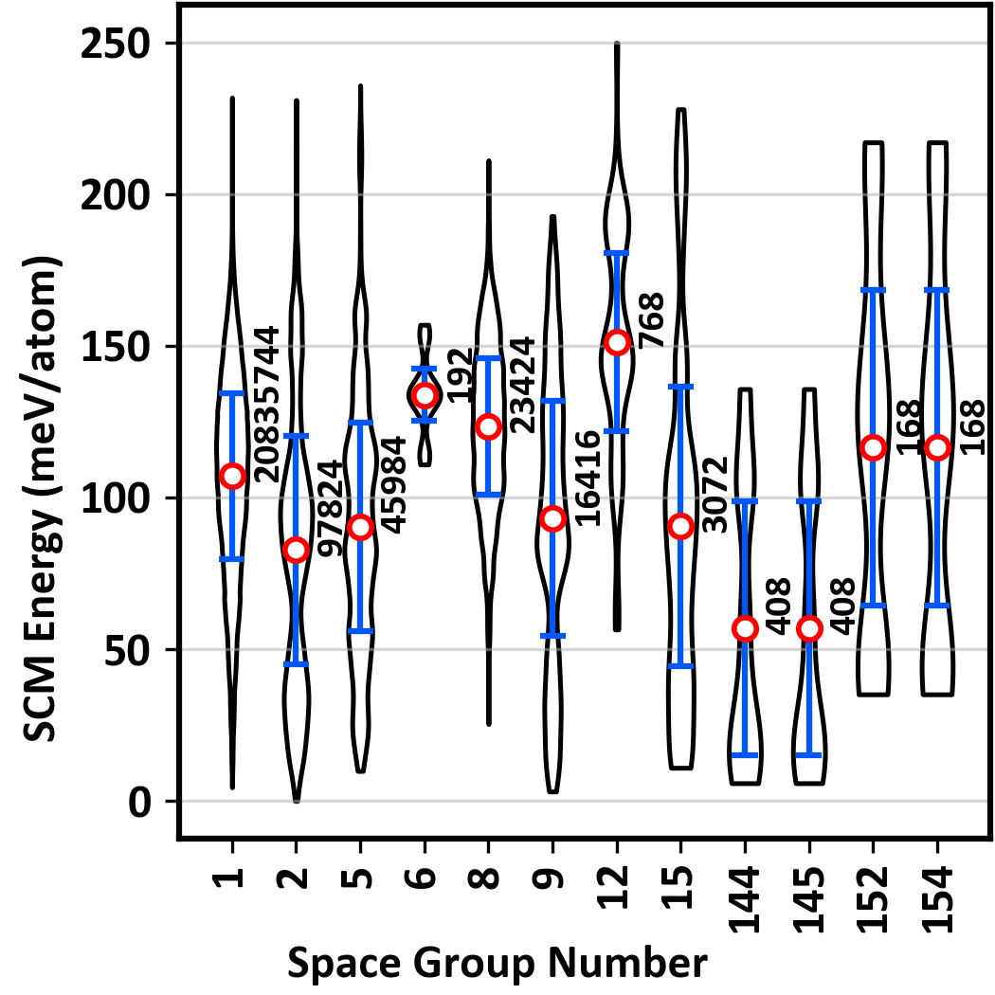
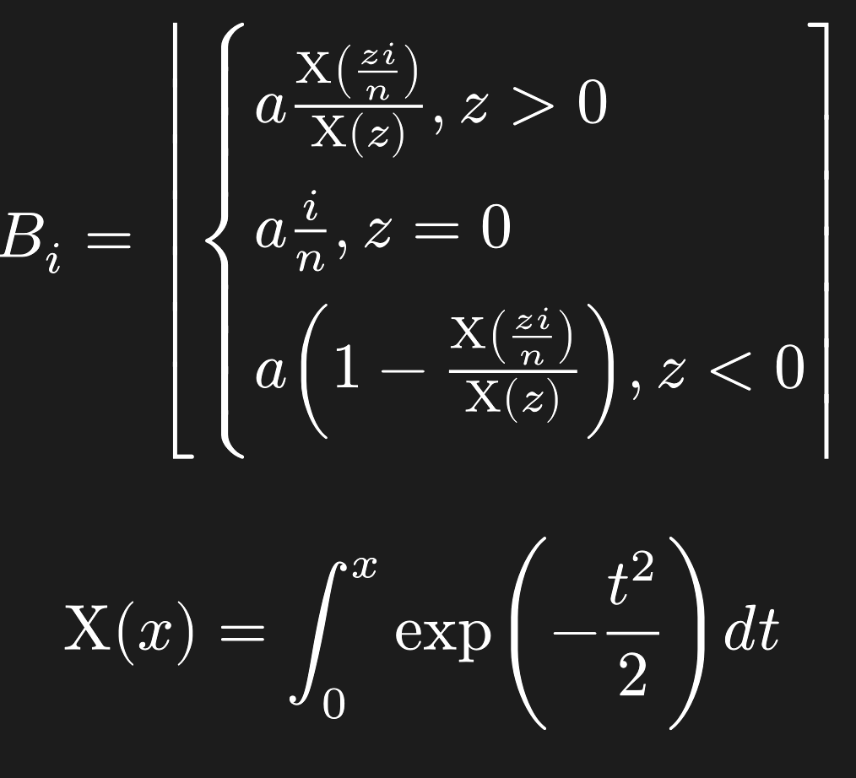
First-Generation Binning
Bias first-generation towards high-symmetry configurations in hopes of finding lower energy configurations faster.
Figure: in-progress research from Khare group
Bi is the i-th bin, a is the number of space groups, n is the number of bins, and z is the bias factor (higher = more aggressive bias in the positive direction)

Slide 5
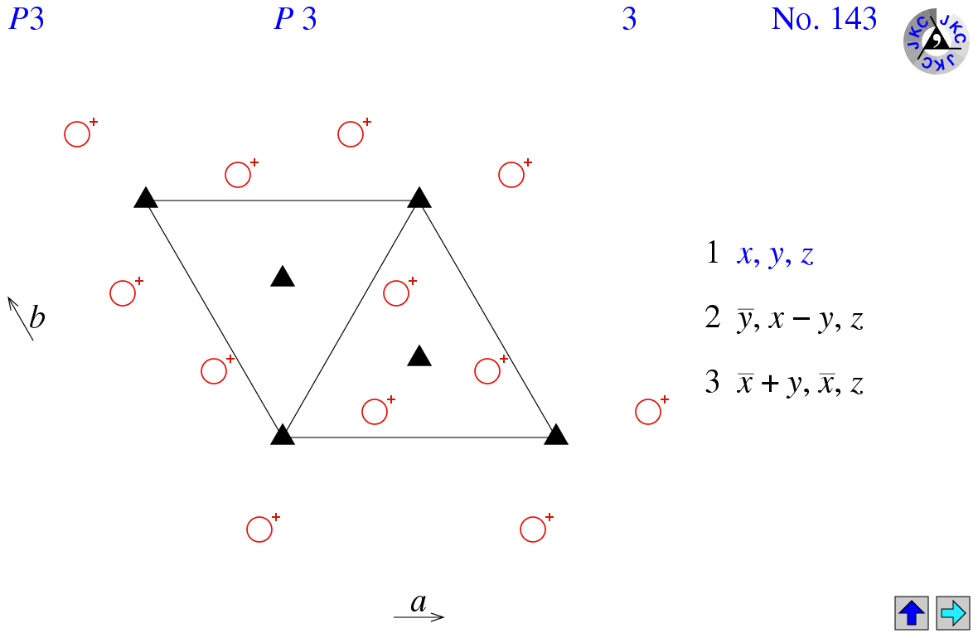
Verifying Validity of Space Groups
Random generation of configurations failed to produce any high-symmetry configurations (space group > 1)
  Generated ~50k configurations, expected frequency of high-order configurations is 0.5%, expect on average 250 high-symmetry configurations for a sample of that size.
Vast majority of space groups are impossible to obtain for this stoichiometry, restricting focus to trigonal groups 143 – 161
“Closed” symmetry group sets demand a num. of sites that is a whole number multiple of num. of operations, “open” sets require that the number of sites shares a factor with num. of operations.
Diagram for space group 143 with listed symmetry operations, from University of London http://img.chem.ucl.ac.uk/sgp/large/143az1.htm
The c basis vector is normal to the plane of the screen.

Slide 6
Forced Generation of High-Symmetry Configurations
To fill first generation, manually generate high-symmetry configurations
  Up-front computational cost of doing so should be less than the additional cost needed to simulate large highly-random early generations
Compiled a database of the symmetry operations in each space group
Verified their closedness v. openness – all groups 143 to 161 are open.
Design considerations for generation script:
  Should be able to sample the entire population of high-symmetry configurations – no unintended bias
  Should be able to input a space group number, index file containing all possible sites in the lattice, and number of configurations desired and output that many configurations in that spacegroup
  In order to qualify for a certain space group, each elemental sublattice must be target space group or greater.

Slide 7
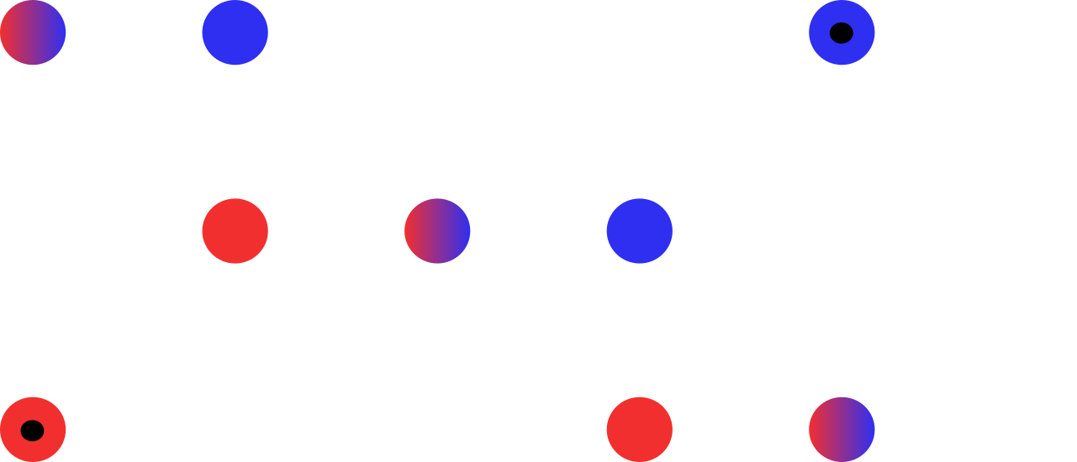
Resolve Overlapping Symmetry Sets
Ag and Bi both need to occupy 9 sites, groups 147-161 have 6 symmetry ops
  Overlap 2 symmetry sets so they share 3 sites
  Generate one set of 6 and all its size-3 subsets
  Generate all size-3 subsets of the inverse symmetry operations except the one that corresponds to the points in the original set
  Convolute these two lists to find possible alternate orgins
  Choose at random one of the possible orgins if there are multiple, generate the rest of points in that set, and make sure that they are within the elemental sublattice

Slide 8
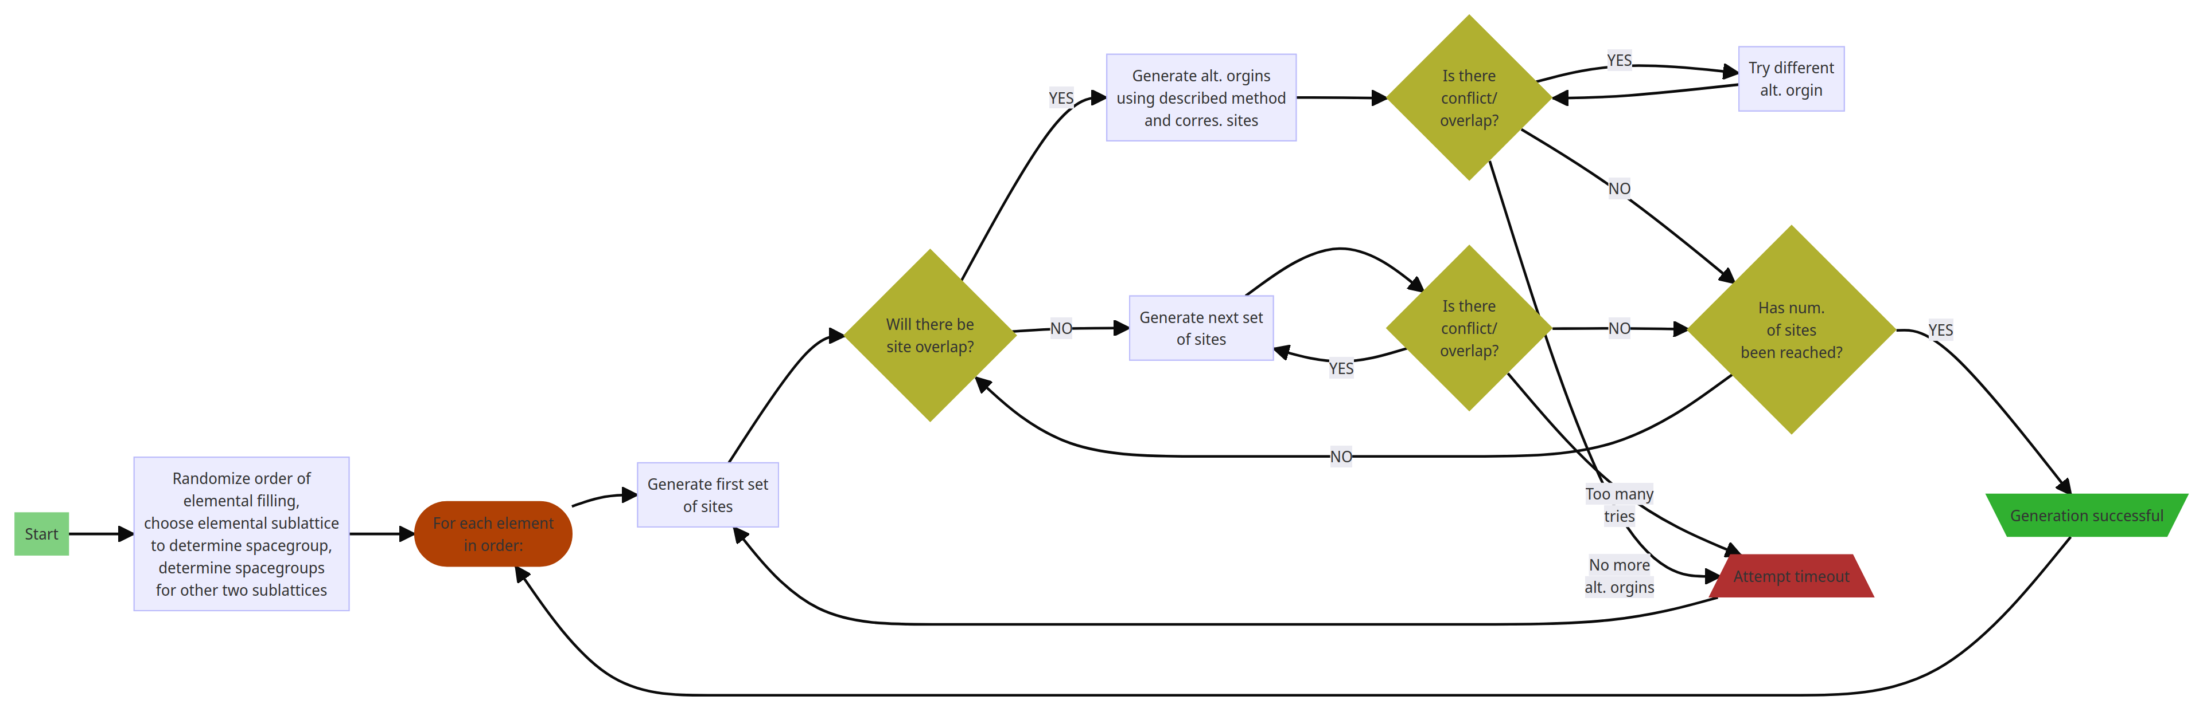

Slide 9
Next Steps, Continued Research
Complete implementation of config. generation algorithm
Generate and simulate first generation using modified binning strategy, use EA to converge on minima
  Tweak and rerun multiple times to refine parameters of evolution, first-generation filling.
Implement and simulate crystal using USPEX software
Compare resulting minima found by both methods, also analyze runtime data to determine computational cost/efficiency
Report findings, hopefully publish results

Slide 10
Thank you!
Ethan Meltzer, Oberlin College Dept. of Computer Science
Mr. Victor T. Barone, Dr. Richard E. Irving, Dr. Sanjay V. Khare
University of Toledo Dept. Of Physics
Questions?
emeltzer@oberlin.edu

